Slide 1

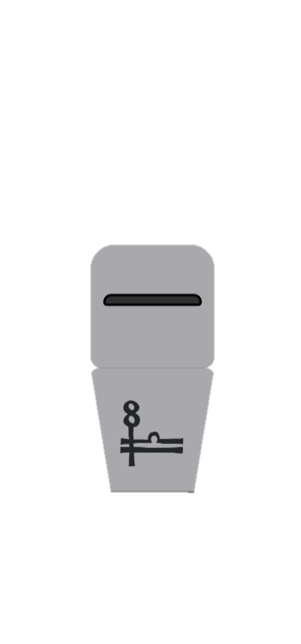



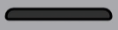








A
B
Learning Phase
Value Dimensions
Transfer Phase
Objective
Value
Relative
Value
Stimulus Presentation
Until choice made
Selection
Display
500 ms
Feedback Presentation
2000 ms
+75
+
High
Reward
Reward
Context
+25
-
-
Low
Reward
Punish
Context
-25
+
Low
Punish
-75
-
-
Neutral
Context
High
Punish

